Slide 1
Salvatore D’Armettas’ Life and Work

Slide 2
Concept
A Resume/Journal including my work, experiences, and hobbies.
Images of experiences and hobbies such as soccer, links to pages we have worked on this semester.
Personal Statement.

Slide 3
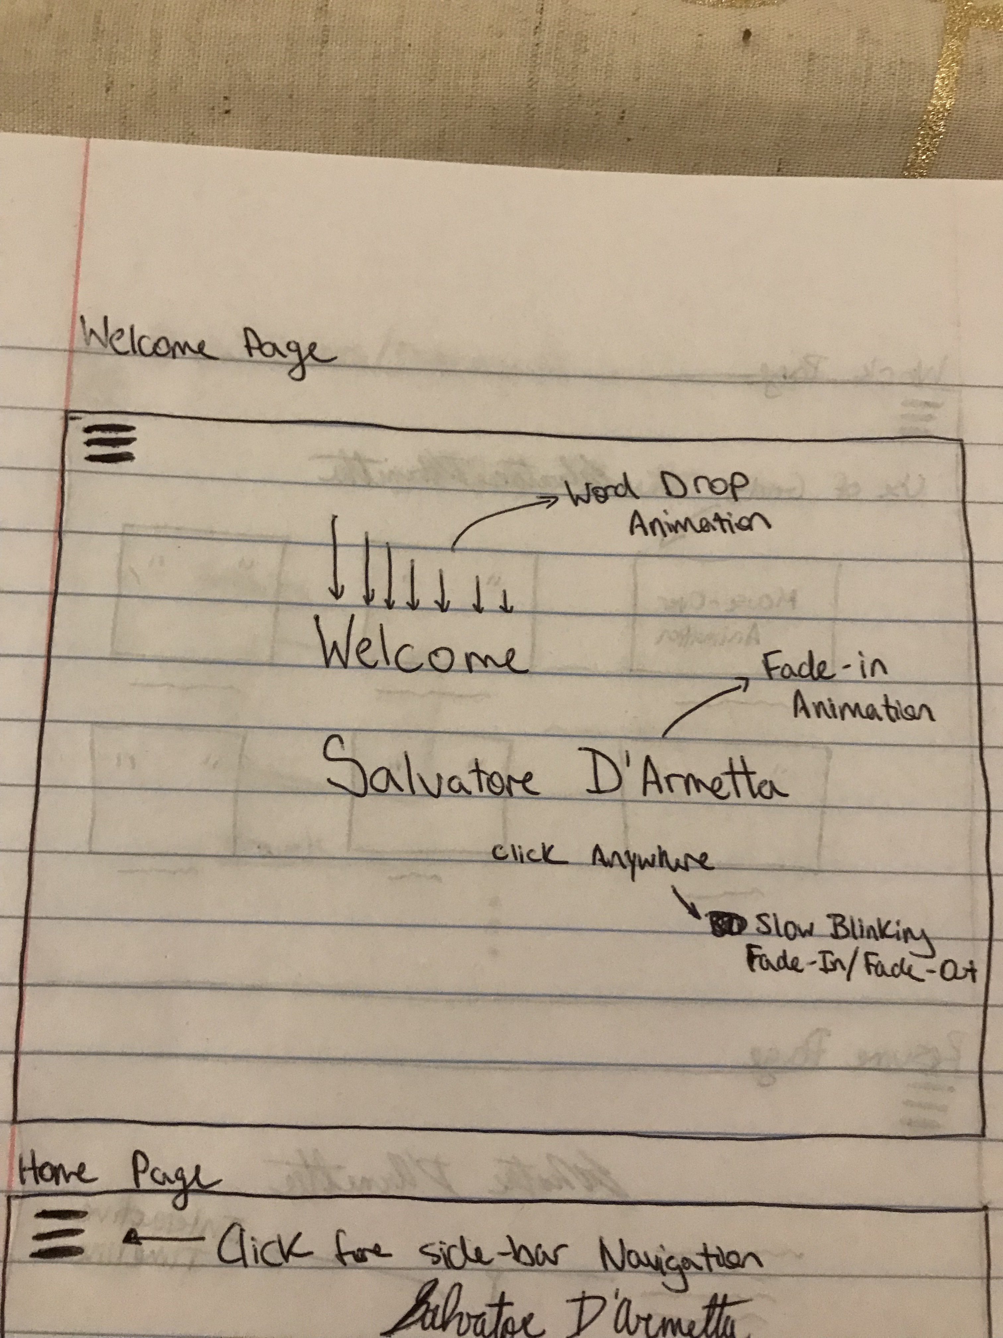
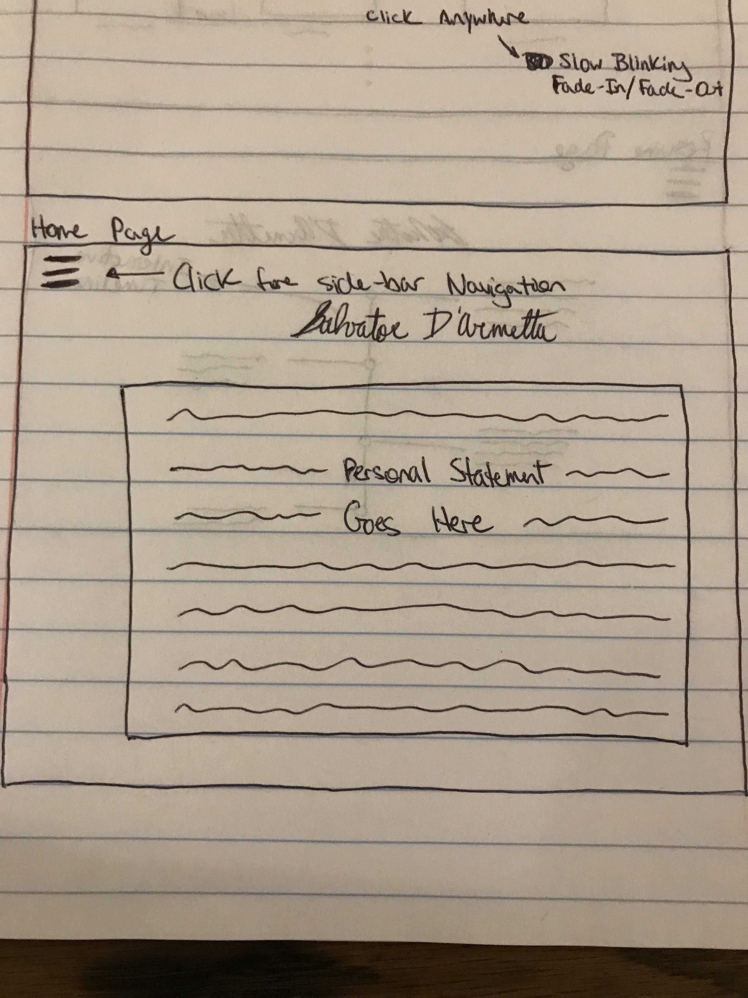
Wireframes

Slide 4
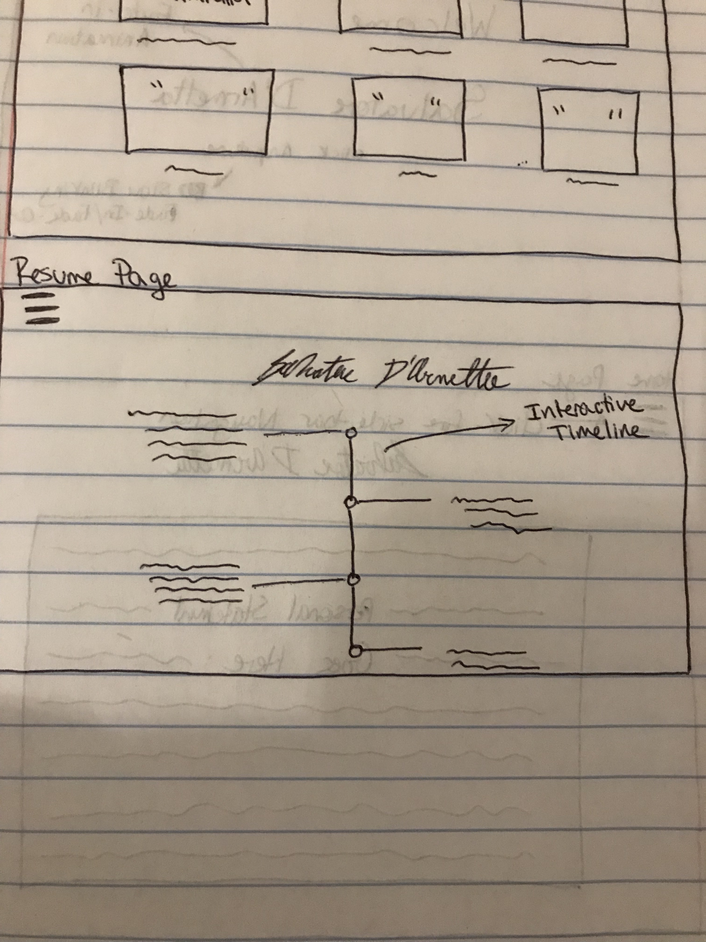
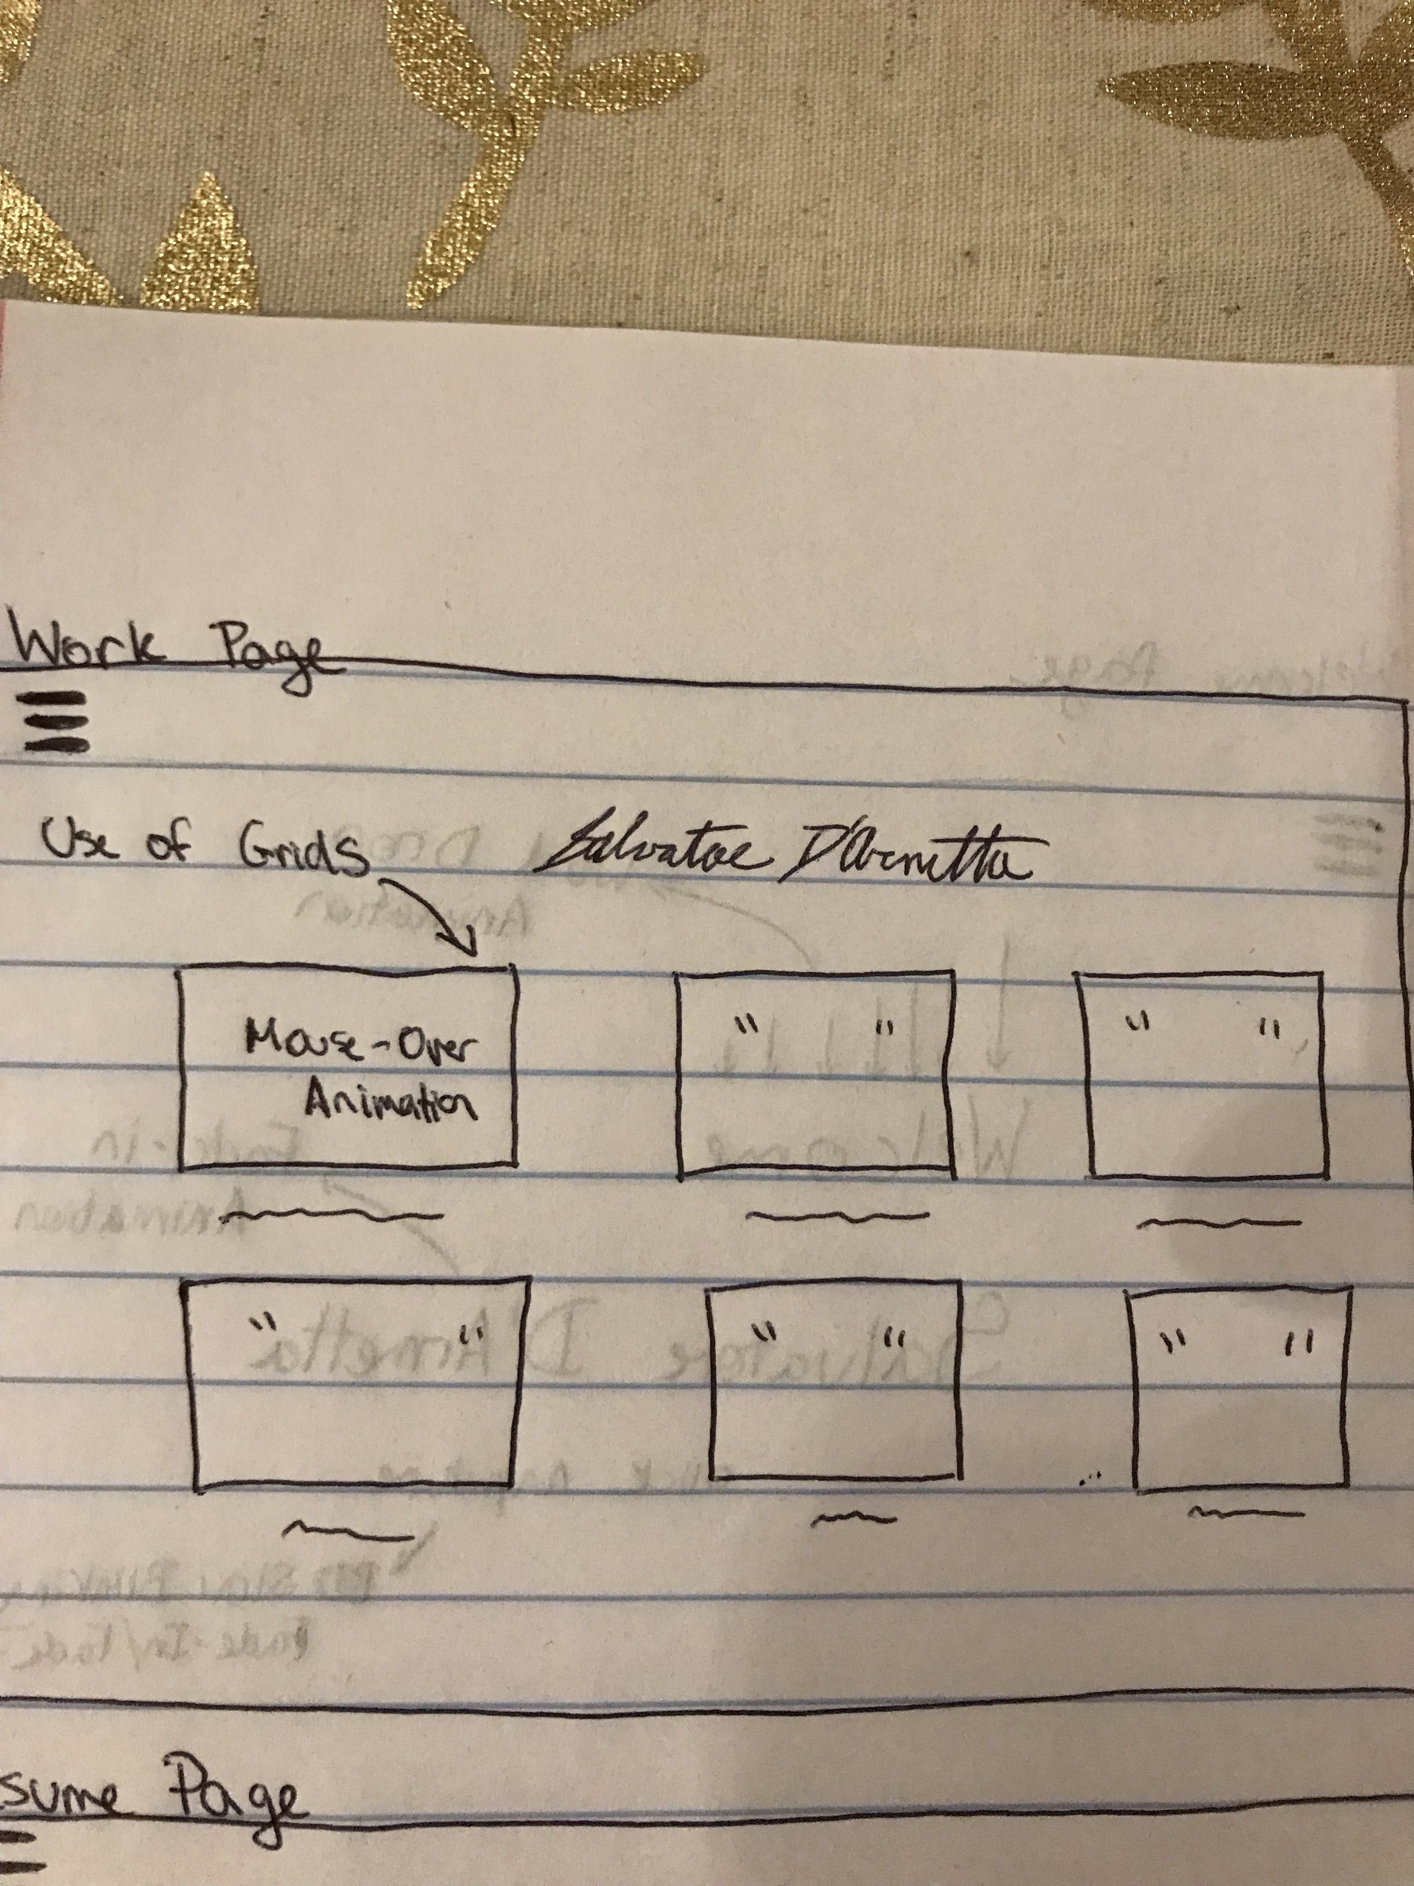
Wireframes

Slide 5
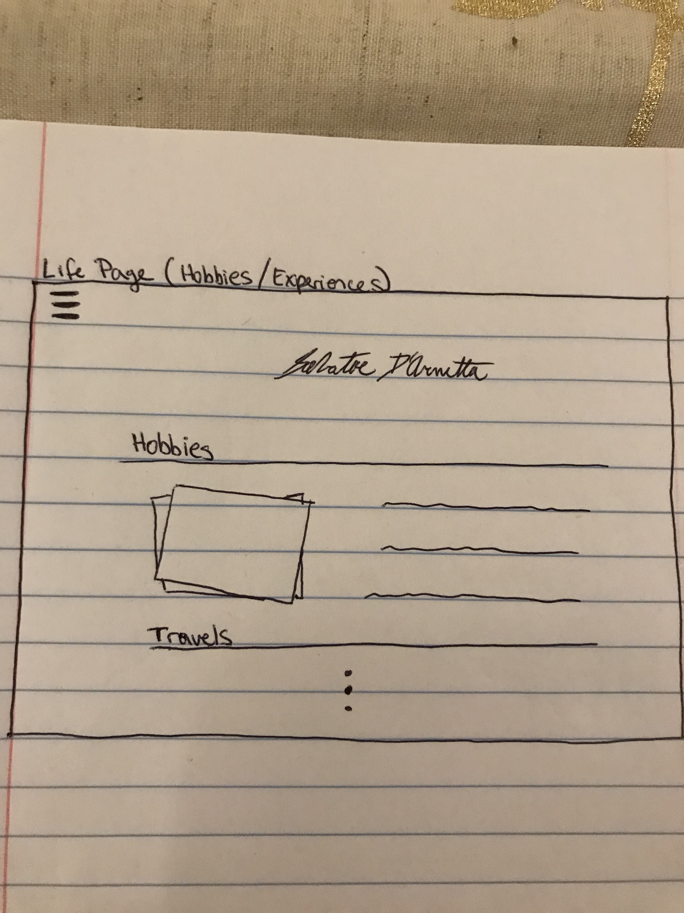
Wireframes

Slide 6


Design
Colors: Mainly Blue and Black.
Icons: Hamburger Icon for Navigation Bar.
Fonts: Cursive for Heading, Georgia for the rest.

